Slide 1
Registries for the Digital Era: Automated, data-driven, and interoperable data ecosystems
Teresa Rodríguez de las Heras Ballell
Full Professor of Commercial Law, Universidad Carlos III de Madrid
teresa.rodriguezdelasheras@uc3m.es

Slide 2
Hypothesis
Technology
Technology
Other functionalities
Role of Registries
Implementation
New roles / new functions
Legal implications

Slide 3
Initial findings
Technology-neutrality approach MLST
I.- Multiplicity of registries
Sectoral / general
Local / domestic / international
Purposes
Organization
II.- Characterization
and effectiveness method
III.- Limited visibility effect
/ fossilization
Data-driven
Interoperable
Automated

Slide 4
Effectiveness against third-parties:
Data-driven registers v. control
1.
Push models
Signalling
Dynamic
Granular
Visible
Oracles
Control
Trading platforms

Slide 5
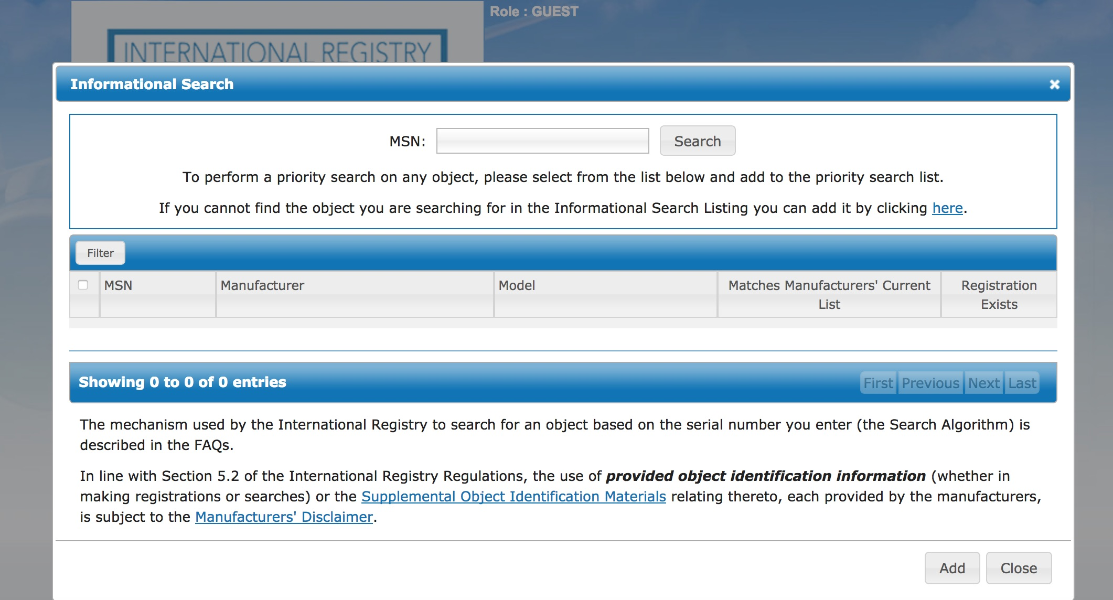


Interoperable registries:
data ecosystem
2.
Data reliability expectations
Liability
Ex officio - upon request

Slide 6

Recommendation 56 of the UNCITRAL Legislative Guide on Secured Transactions:
‘The law should provide for the allocation of responsibility for loss or damage caused by an error in the administration or operation of the registration and searching system. If the system is designed to permit direct registration and searching by registry users without the intervention of registry personnel, the responsibility of the registry for loss or damage should be limited to system malfunction
Article 32 LMST - Limitation of liability of the Registry
Three options
Article 28(1) CTC:
‘The Registrar shall be liable for compensatory damages for loss suffered by a person directly resulting from an error or omission of the Registrar and its officers and employees or from a malfunction of the international registration system except where the malfunction is caused by an event of an inevitable and irresistible nature, which could not be prevented by using the best practices in current use in the field of electronic registry design and operation, including those related to back-up and systems security and networking.’

Slide 7


ELI Guiding Principles on Automated Decision-Making
Model Law on Automated Contracting
July 2024
UNCITRAL WG IV on E-Commerce
Use of AI in international trade
Legal recognition rules
Decision and action attribution rules
Contracts in machine code and with dynamic information
Error rules
Treatment of unexpected or unforeseen action

Slide 8
Article 4. Technology neutrality
Nothing in this Law requires the use of an automated system or a particular method in automated systems to form or perform contracts.
Article 5. Legal recognition of automated contracting
A contract formed using an automated system shall not be denied validity or enforceability on the sole ground that no natural person reviewed or intervened in any action carried out in connection with the formation of the contract.
An action carried out by an automated system in connection with the formation or performance of a contract shall not be denied legal effect, validity or enforceability on the sole ground that no natural person reviewed or intervened in the action.

Slide 9
Article 6. Legal recognition of contracts in computer code
and use of dynamic information in automated contracting
A contract shall not be denied validity or enforceability on the sole ground that the terms of the contract are contained in data messages in the form of computer code.
A contract shall not be denied validity or enforceability on the sole ground that the terms of the contract incorporate information from a data source that provides information that changes periodically or continuously.
An action in connection with the formation of a contract shall not be denied legal effect, validity or enforceability on the sole ground that the action involves processing data messages containing information from a source that provides information that changes periodically or continuously.

Slide 10
I.- Technology impacts on the role of registries
II.- Technology impacts on risk allocation
III.- Technology-neutrality: Electronic registers are, nonetheless, designed and operate as traditional registers
IV.- Data-driven registry system focuses on data accessibility (signaling effect)
V.- Liability rules should be adapted to core functions
VI.- Automation may enhance effectiveness of traditional registers.

Slide 11
Teresa Rodríguez de las Heras Ballell
Full Professor of Commercial Law, Universidad Carlos III de Madrid
teresa.rodriguezdelasheras@uc3m.es

