Slide 1


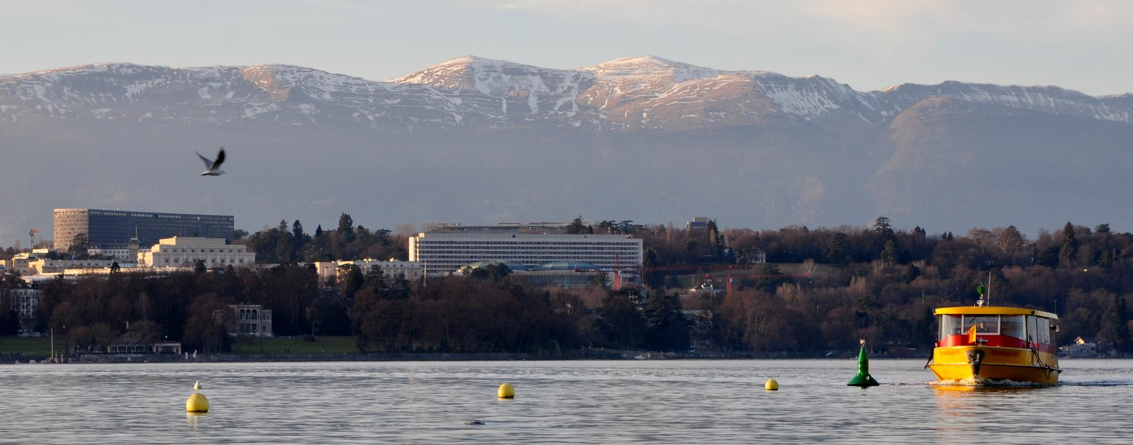
Post-COVID Trends
in International Supply Chains
Jan Hoffmann
Head, Trade Logistics Branch, UNCTAD
Jan.Hoffmann@UNCTAD.org -
13 June 2023

Slide 2
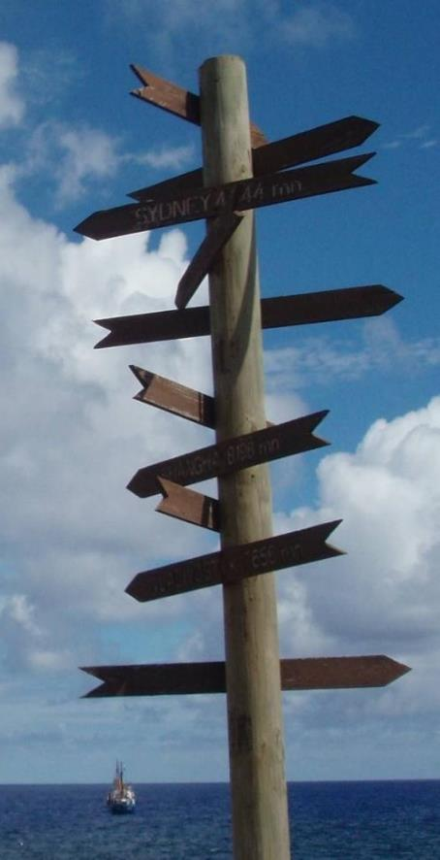
BC:
Long term trends
Before Corona
DC:
Supply chain crisis
During Corona
AC:
Long term perspectives
After Corona

Slide 3
BC:
Long term trends
Before Corona
DC:
Supply chain crisis
During Corona
AC:
Long term perspectives
After Corona

Slide 4
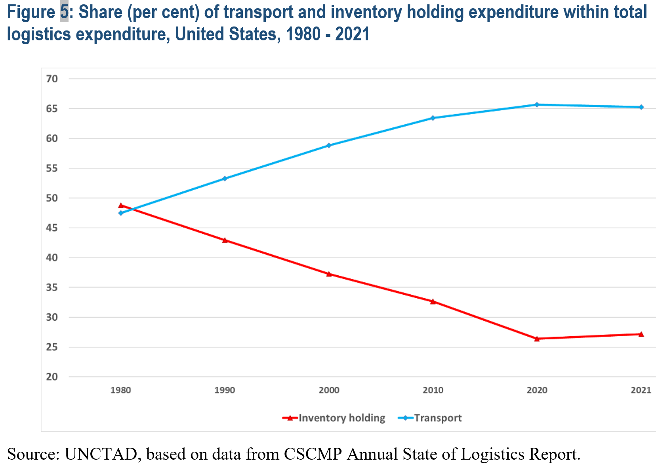

Presented in Issues Note on Geography of Trade, TDB

Slide 5
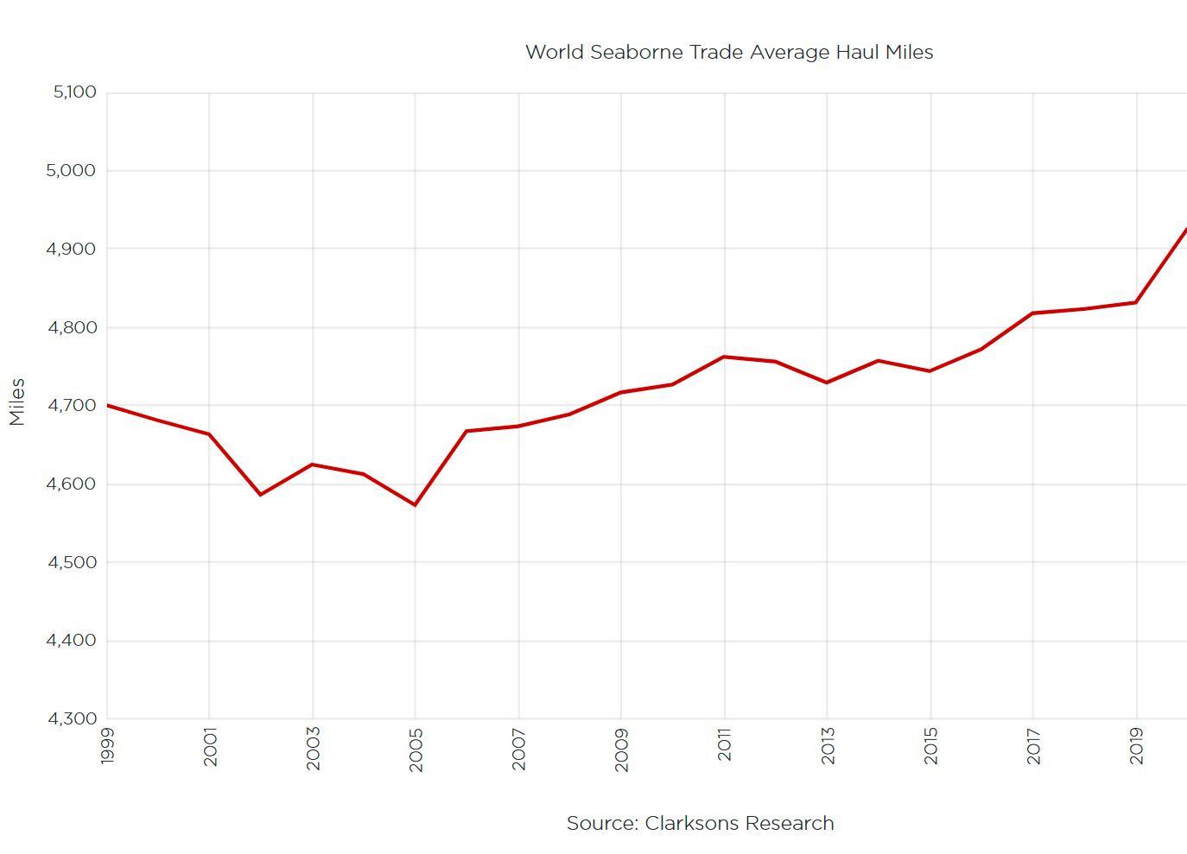

Slide 6
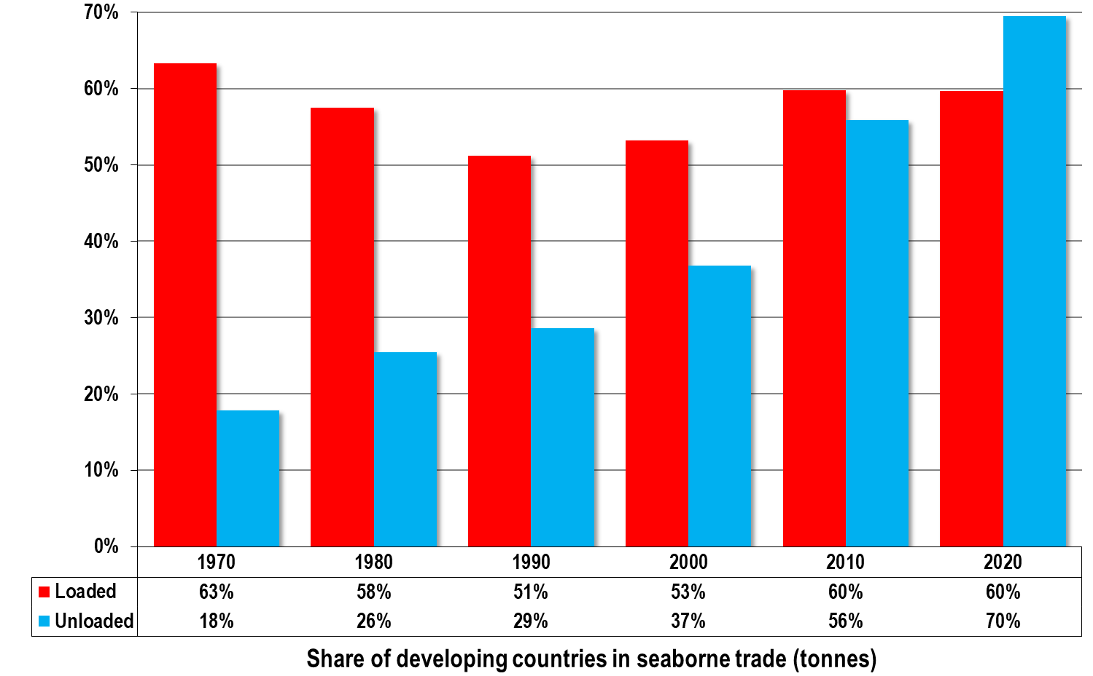
Seaborne trade: share of developing countries
Source: Review of Maritime Transport 2021

Slide 7
BC:
Long term trends
Before Corona
DC:
Supply chain crisis
During Corona
AC:
Long term perspectives
After Corona

Slide 8
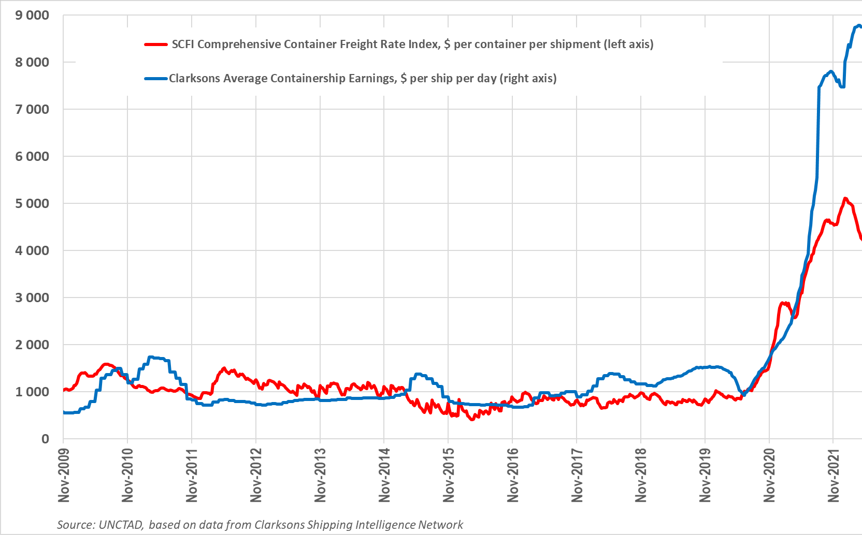
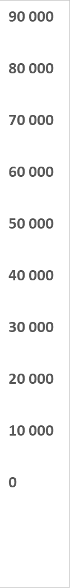

Slide 9
Freight
Rate
Demand
Volume

Slide 10
Freight
Rate
Supply
Volume

Slide 11
Freight
Rate
Demand
Supply
A
Volume

Slide 12
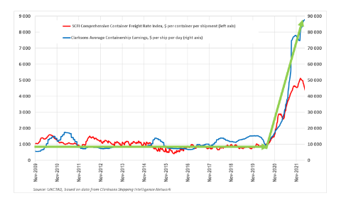
Freight
Rate
Demand
Supply
B
A
Volume

Slide 13
Simulated Impact of container freight rate surges
Hardest hit will be SIDS

Slide 14
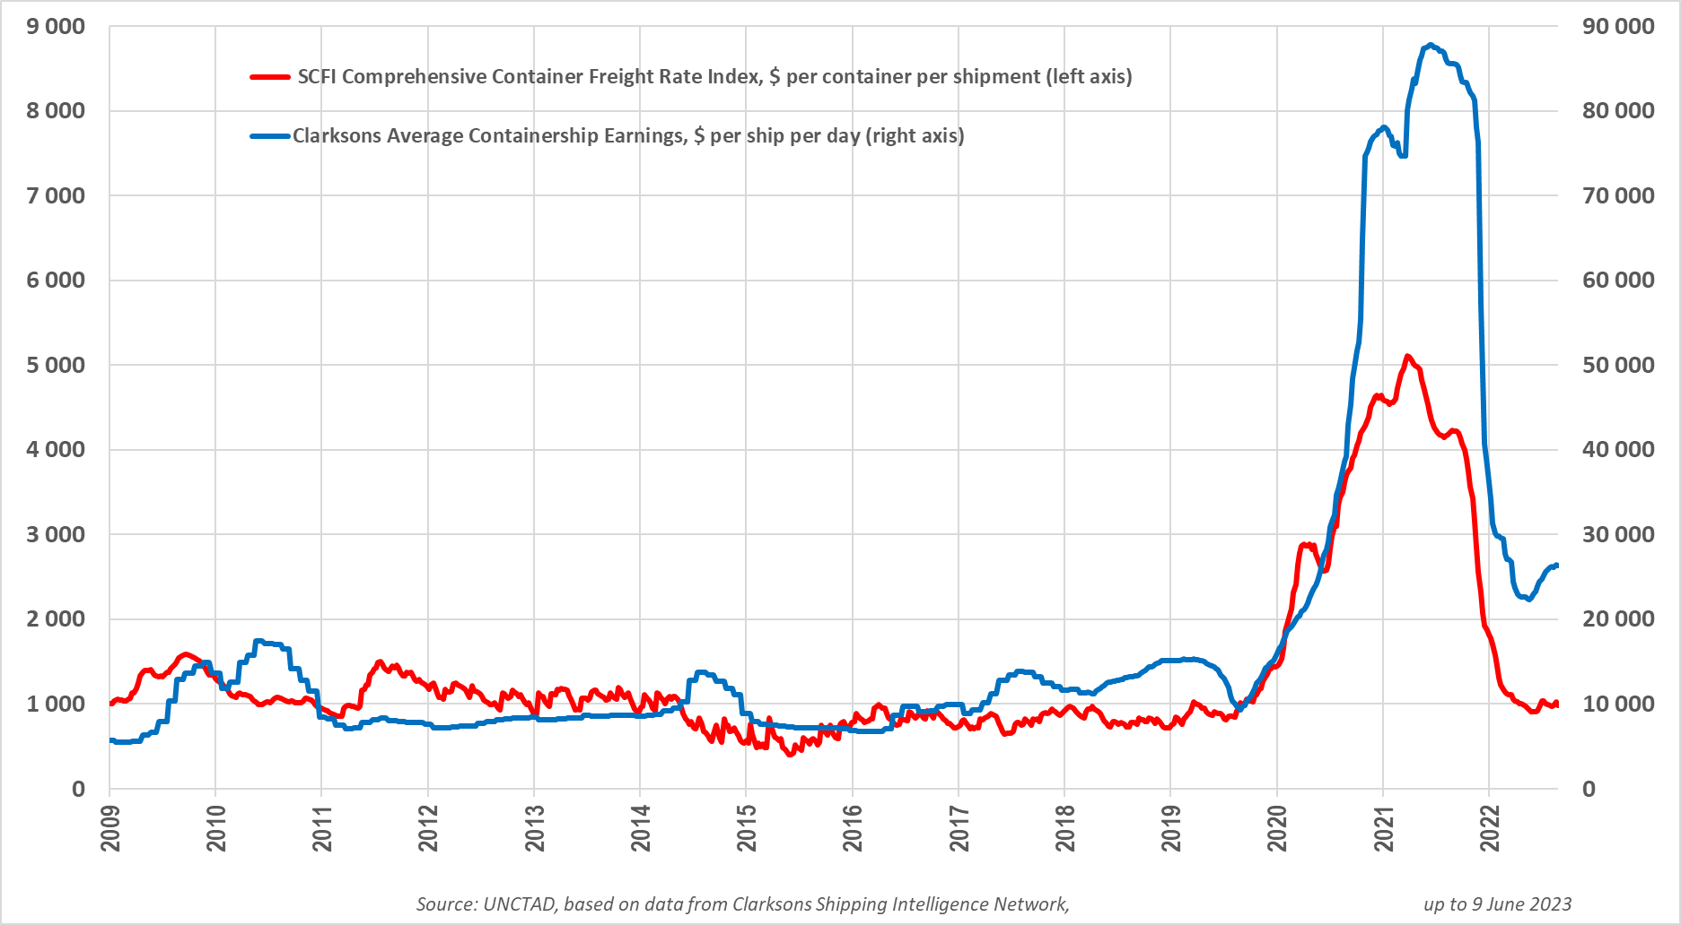

Slide 15

BC:
Long term trends
Before Corona
DC:
Supply chain crisis
During Corona
AC:
Long term perspectives
After Corona

Slide 16
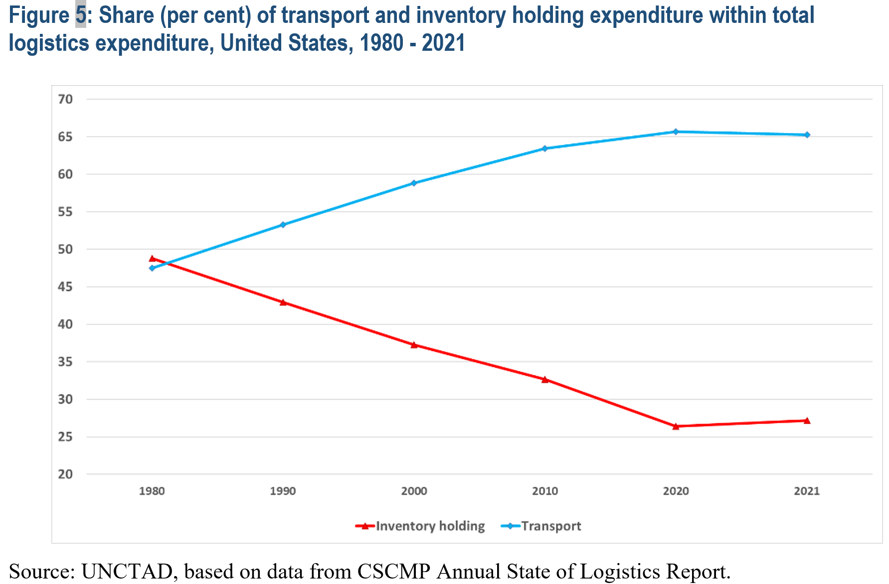
Presented in Issues Note on Geography of Trade, TDB

Slide 17
Presented in Issues Note on Geography of Trade, TDB

Slide 18
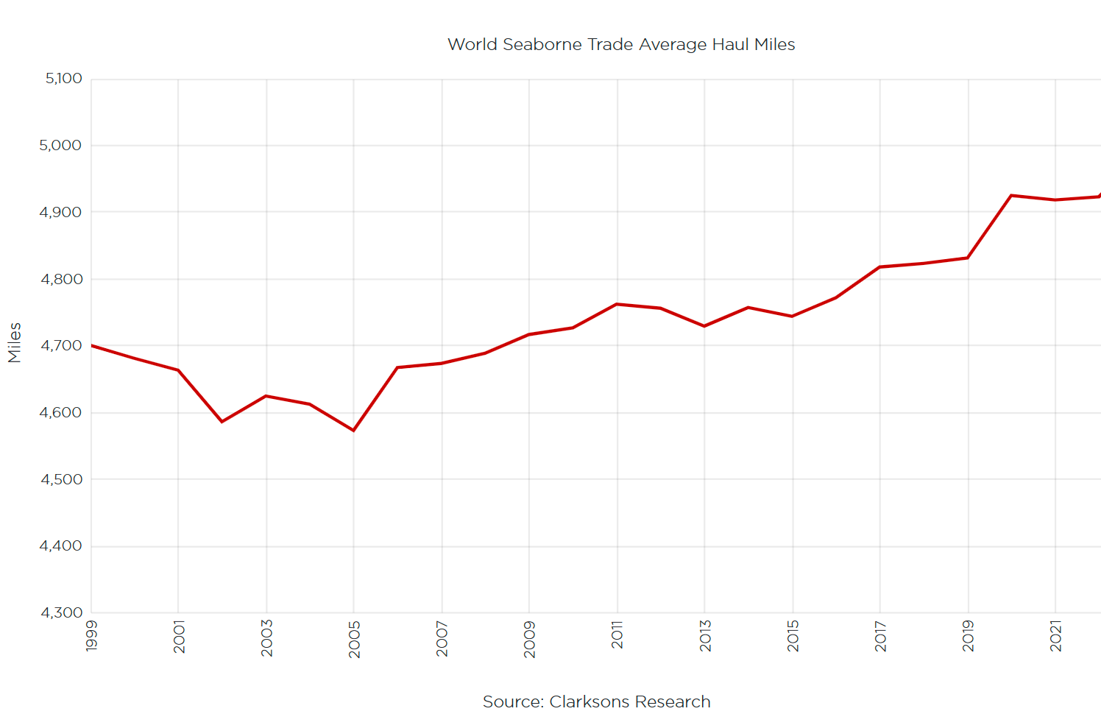

Slide 19
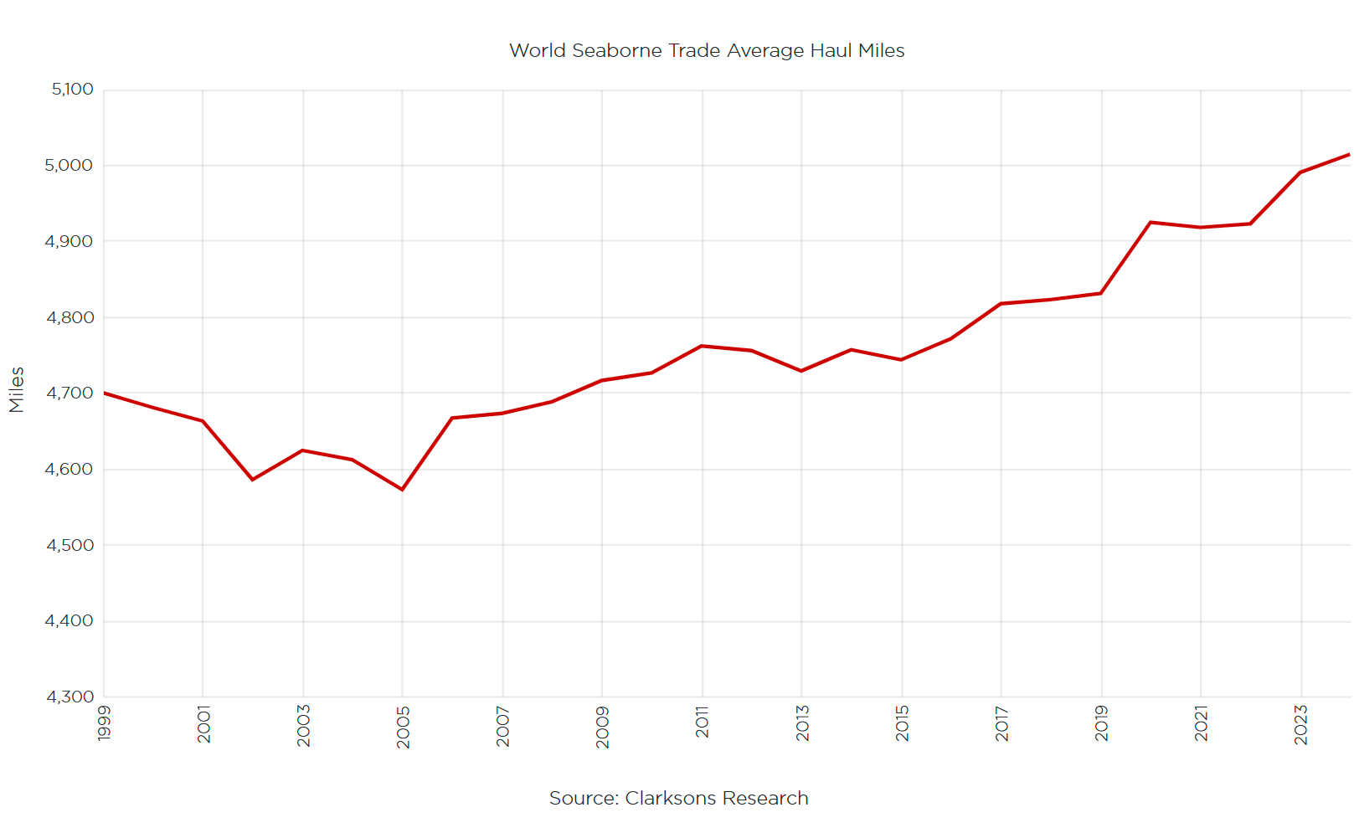

Slide 20
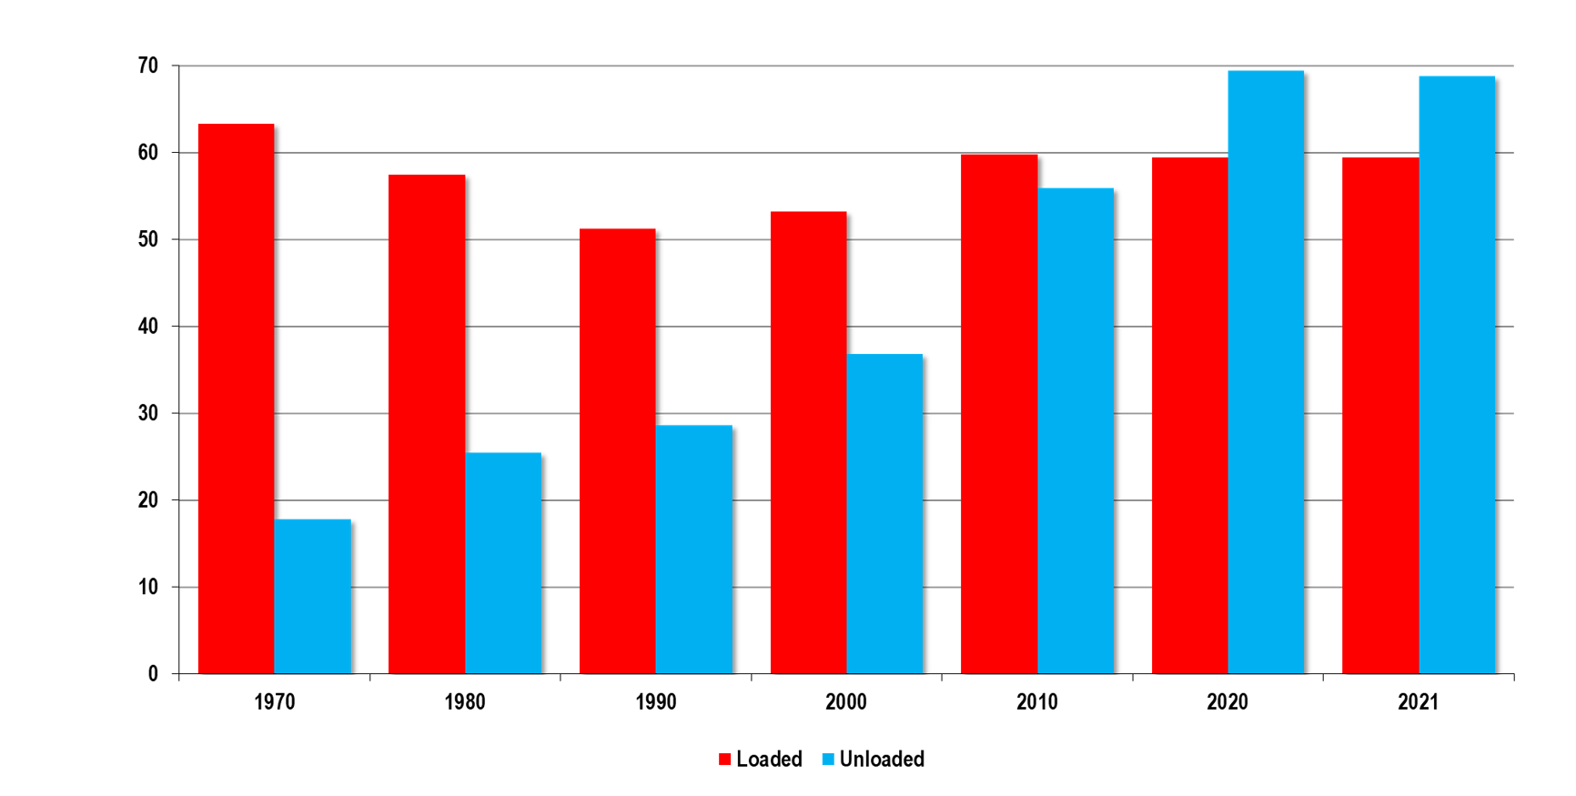
Seaborne trade: share of developing countries

Slide 21
Seaborne trade: share of developing countries

Slide 22
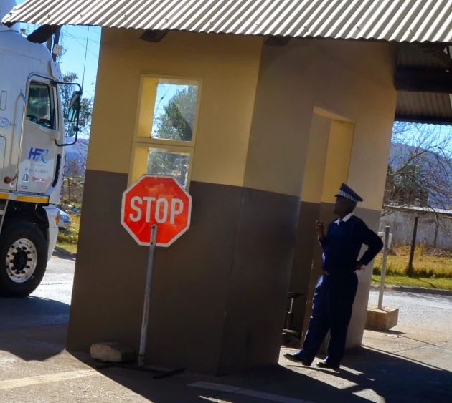

Who leads the IT reforms in your company?
The CEO
The CTO
Covid-19

Slide 23
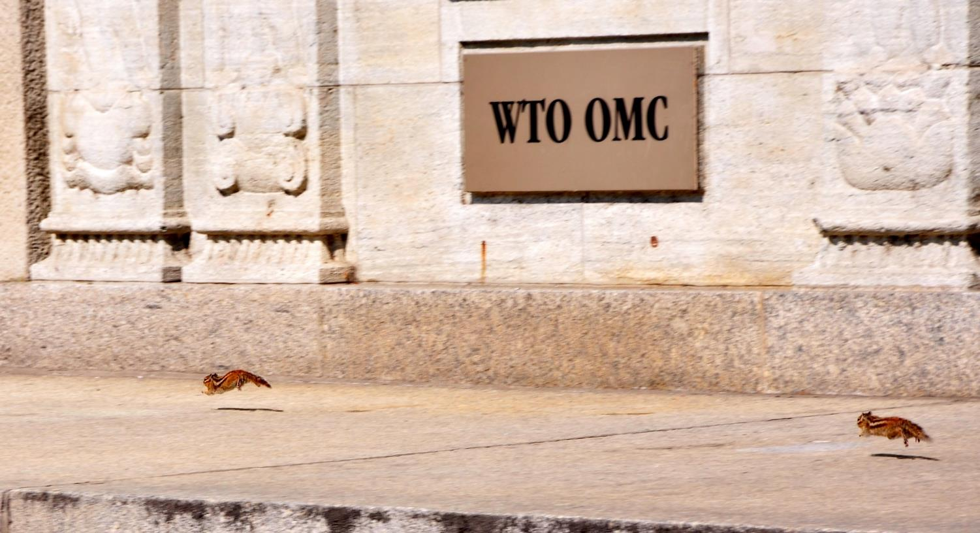
Technological progress will never be as slow as today
How to set today’s rules for the future?

Slide 24

The negotiation, ratification and implementation of conventions take time
Need to commit to whatever is the best [future] technological solution

Slide 25
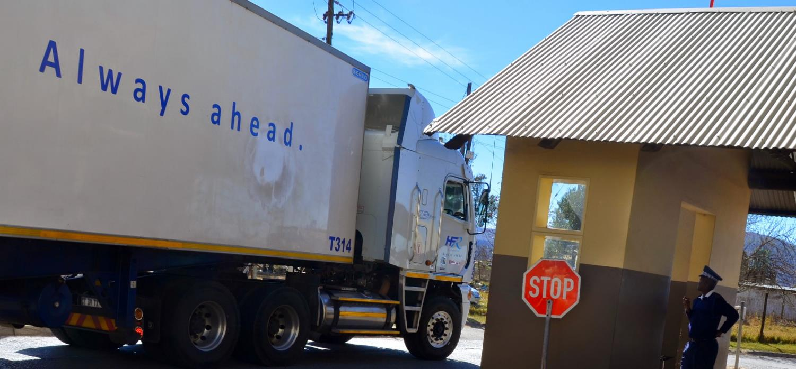
A dynamic dimension in the TFA
In the long term, Article 10.1 will gain in importance,
it does not prescribe any specific technological solution.

Slide 26
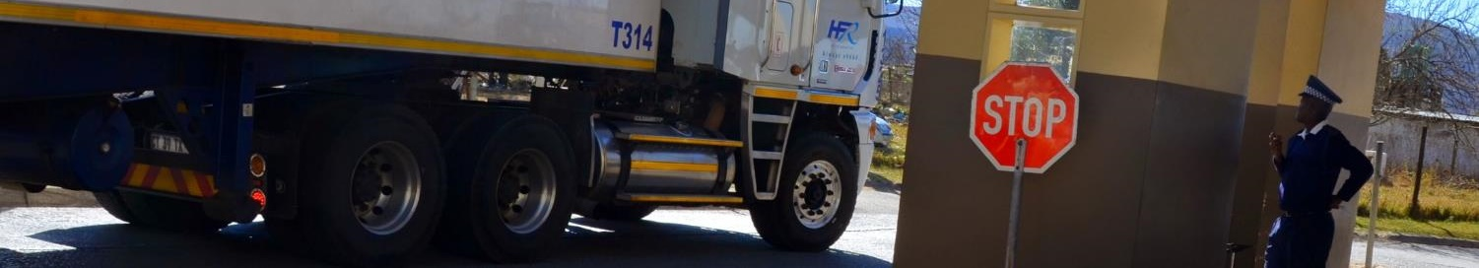
A dynamic dimension in the TFA
In the long term, Article 10.1 will gain in importance,
it does not prescribe any specific technological solution.
Progressively, various provisions will become antiquated or obsolete and we will just want to minimize “the incidence and complexity of import, export, and transit formalities”; continuously “review” requirements; keep “reducing the time and cost of compliance for traders and operators”; and always choose “the least trade restrictive measure” (10.1 TFA)

Slide 27
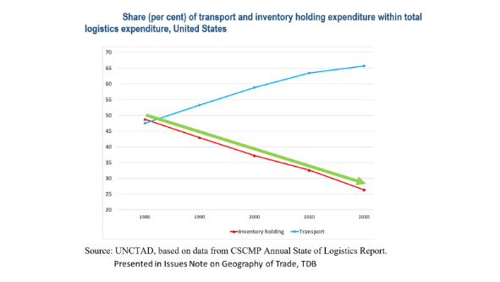
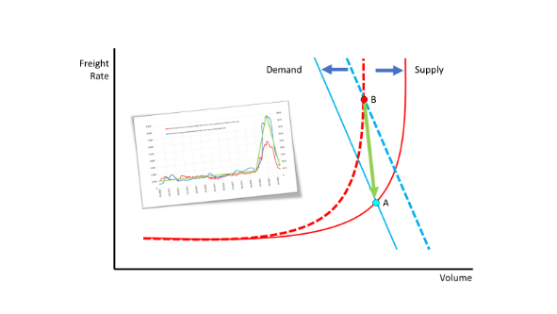
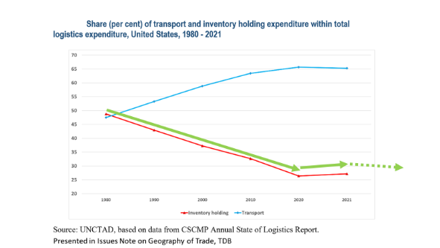
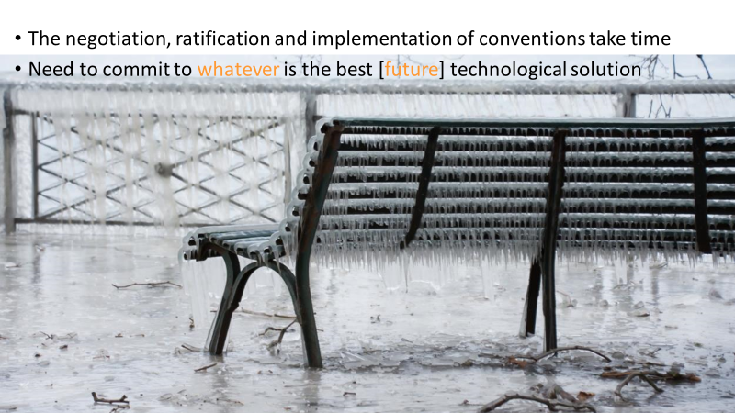
BC:
Long term trends
Before Corona
DC:
Supply chain crisis
During Corona
AC:
Long term perspectives
After Corona

Slide 28
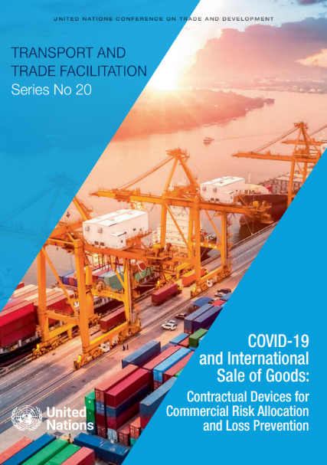
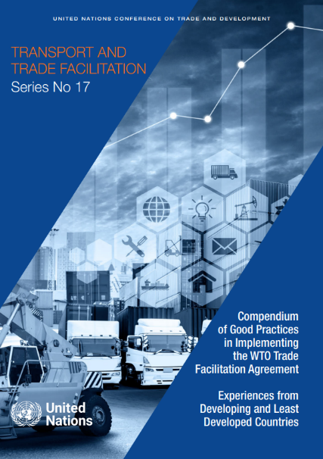
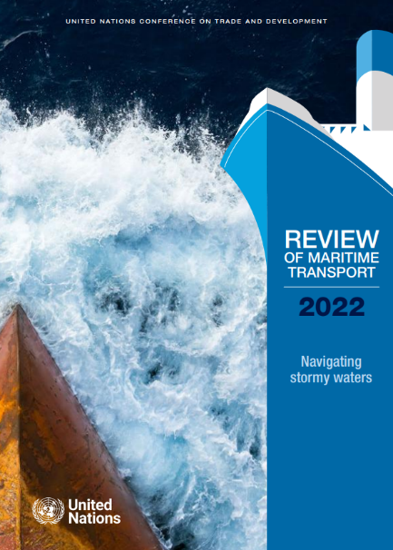
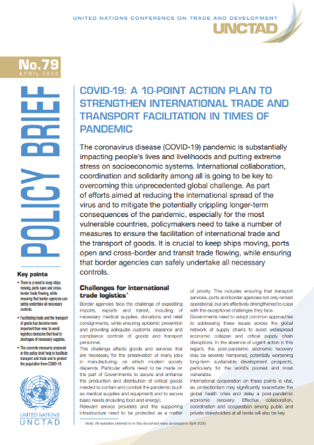
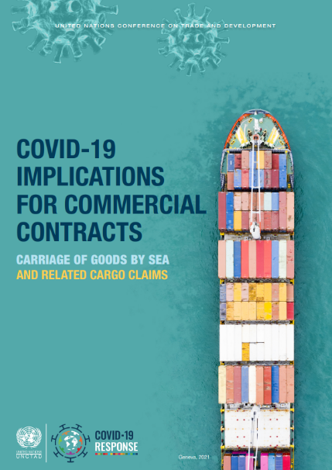
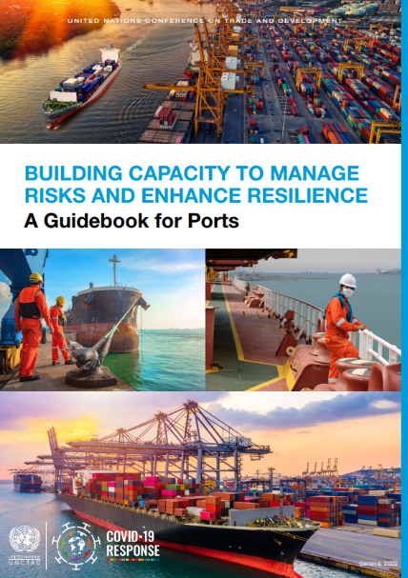
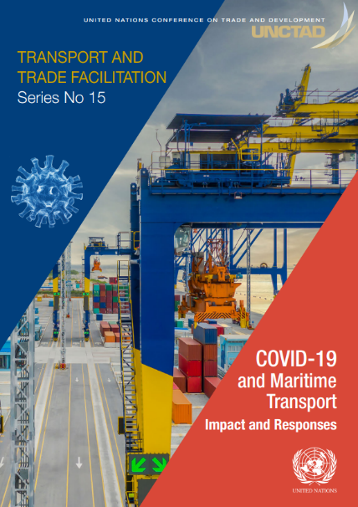
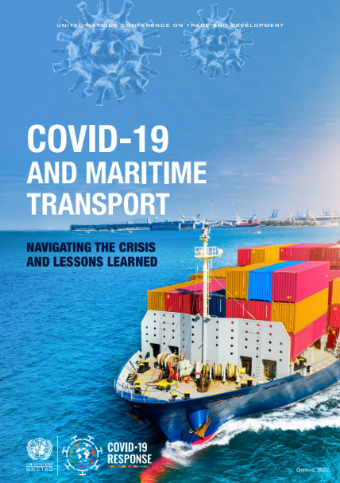
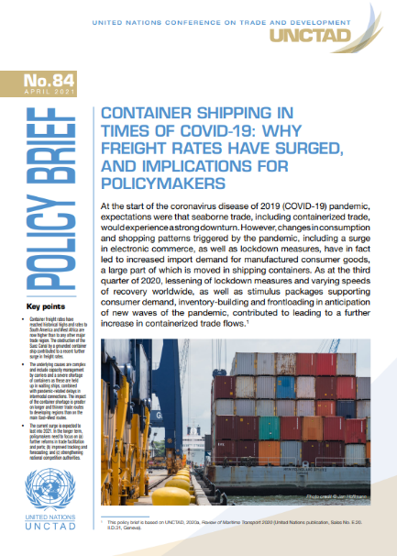
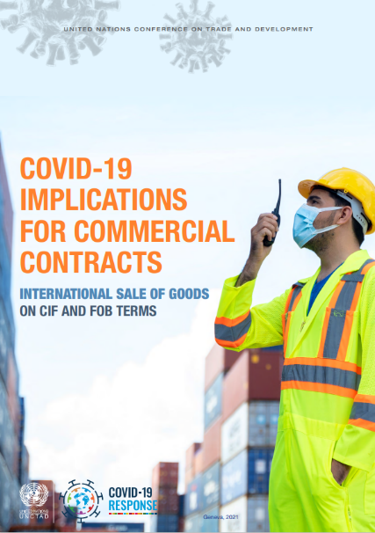
Further reading
https://unctad.org/topic/transport-and-trade-logistics

Slide 29
Post-COVID Trends
in the International Supply Chain
Jan Hoffmann
Head, Trade Logistics Branch, UNCTAD
Jan.Hoffmann@UNCTAD.org -
13 June 2023

