Slide 1
Collaborative Contracting Across Industries
Matthew Jennejohn, Associate Professor of Law, BYU
@ UNCITRAL
Version: 1.2 (25 March 2019)

Slide 2
Key Points
These are some of the important points this presentation will make
Contractual networks are critical for growth
Multi-party agreements are important legal tools in those networks
Understanding the role of contracts in these networks requires a careful study of transactional context
Intellectual property rights are crucial
Markets are dynamic, and industries evolve
Public institutions are necessary to maintain and diffuse this governance structure

Slide 3
The Central Economic Puzzle How can companies de-verticalize innovation processes without exposing themselves to the costs of contractual incompleteness?

Slide 4
The Conventional Wisdom on the Cost of Incompleteness Most of the contract economics literature focuses upon the hold-up problem as the key issue in incomplete contracting

Slide 5
How Parties Cope With Hold Up
Since Macauley (1963) and Macneil (1974, 1978), theory has included both formal and informal institutions
Formal Enforcement
Informal Enforcement
Contractual obligations are enforced through recourse to a third party tribunal
Breach determined by reference to agreement and precedent
Third party tribunal is a public court or a private arbitrator
What we focus on in the 1L Contracts course
Contractual obligations are enforced through social constraints
Repeated dealings
Reputational effects
Breach determined by reference to social norms or commercial practice
An autarkic model of community enforcement

Slide 6
A key question is how
formal and informal contracts interact
Notes:
This matters for many product and capital markets, which rely heavily on networks for governance functions.
This matters for contract law to the extent contract design shapes the enforcement regime.

Slide 7
The Formal/Informal Interface
Two theories of the relationship between formal and informal contracting have emerged
Substitutionary
Theories
Complementarity Theories
“Crowding out” thesis: formal enforcement undercuts informal governance institutions, built upon notions of repeated dealings or reciprocity
Brief pedigree:
Theory originates in Macauley (1963) and refined in subsequent work (e.g. Macneil 1974, 1978, Klein 1996)
Developed into part of the argument for minimalist intervention (e.g. Schwartz & Scott 2003)
Formal contracting supports informal governance
Brief pedigree:
Poppo & Zenger (2002) provide initial empirical evidence
Gilson, Sabel & Scott (2009, 2010) outline “braiding” theory
Bozovic & Hadfield (2016) outline “scaffolding” theory

Slide 8
Common Terms In Alliance Contracts
An equity stake could be a complementary governance tool
Project Plan
Administrative Mechanisms
Background IP Licensing
Foreground IP Ownership
Provides a roadmap for the collaboration
May not be complete by the start of the collaboration
Updated regularly
Central tasks:
Articulating the project plan
Updating the plan
Deciding whether milestones achieved
Parties license their relevant background IP to one another
Exclusive or non-exclusive bases
Determines who will own the foreground IP resulting from the collaboration
Sole ownership v. joint
Milestones
Indemnification
Termination
Dispute Resolution
Some compensation may be provided upfront
Remaining compensation is structured as an earnout
E.g., indemnities relating to intellectual property claims
Can be particularly important in industries where product liability claims are potent
For cause v. at will
Options on IP ownership depending on who terminates and when
In US, typically DE or NY law chosen
Arbitration frequently used in biopharma
Dispute resolution bifurcated depending upon claim type

Slide 9
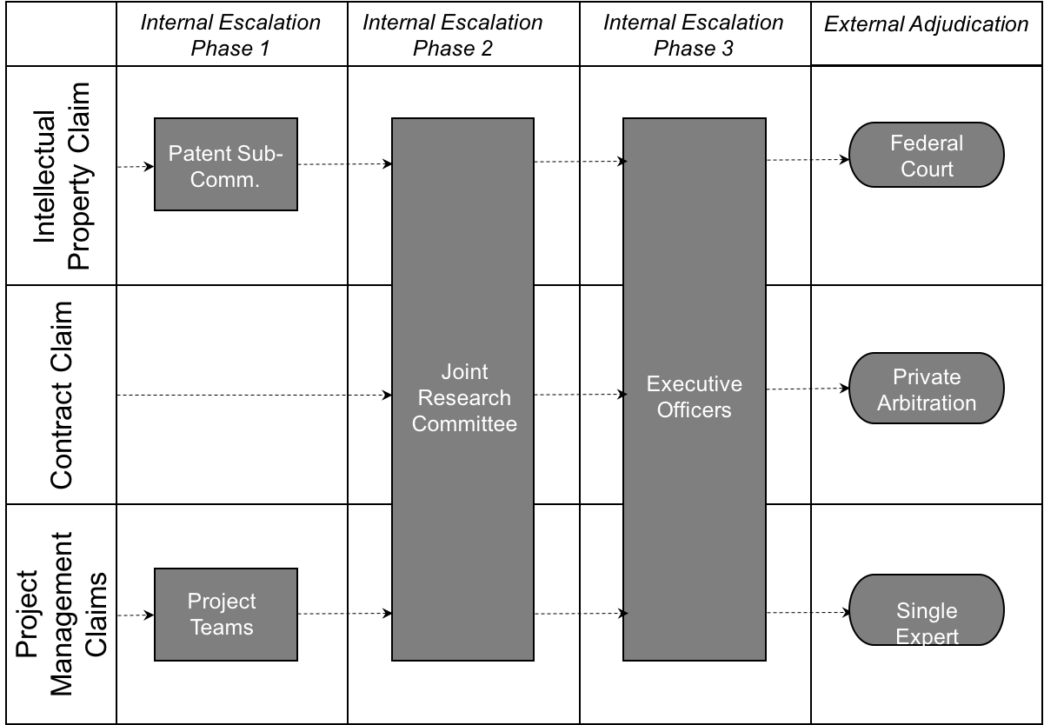
The Core of the Braiding Mechanism
A governance committee has decision authority, has equal numbers of representatives, and operates by a unanimity rule
Source: Jennejohn 2016

Slide 10
Evidence from Automotive Preliminary research suggests that new collaborative contractual mechanisms are being introduced in North American supply chain relationships

Slide 11
The “Conventional” Supply Chain
Three basic governance layers (the top layer is where new developments are occurring)
Joint Development Agreements
Strategic Supplier
Engagement
Advanced Procurement/ Joint Development
All Supply Chain Activities
ISO 9001
IATF 16949
OEM Supplier Manual
Foundation
Standard
Terms & Conditions

Slide 12
Transforming Conventional Relations
The North American Working Relations Index grades the major OEMs on how they collaborate with their supply chain
Source: PPI

Slide 13
The Role of Disruptive Technologies
New technologies (autonomous/electric/mobility) are also driving greater collaboration

Slide 14
The Role of Disruptive Technologies
Multi-party alliances are pursued to build platforms for emerging technologies

Slide 15
What explains variation
in the use of governance mechanisms?
Notes:
This matters for many product and capital markets, which rely heavily on networks for governance functions.
This matters for contract law to the extent contract design shapes the enforcement regime.

Slide 16
Networks as a Source of Variation Certain contractual mechanisms are used more when networks exacerbate intellectual property spillovers and coordination problems

Slide 17
Bernstein’s Thesis
Bernstein’s recent work argues that collaboration networks are self-governing
Beyond Relational Contracts (2015)
Qualitative study of equipment supply chains in Upper Midwest
Argues that network position facilitates reputational sanctions
Contract Governance in Small World Networks (2019)
Qualitative study of 11th century Maghribi trading network
Argues that small world network structure supports reputational sanctions across large, dispersed markets
In short, the small world network structure allows reputation to operate in automotive, aerospace and biotech, just like it does in commodity markets, like wholesale diamonds, grain & feed, cotton, etc.

Slide 18
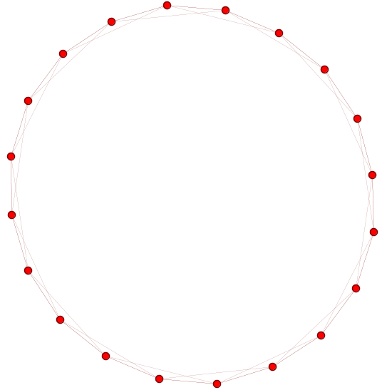
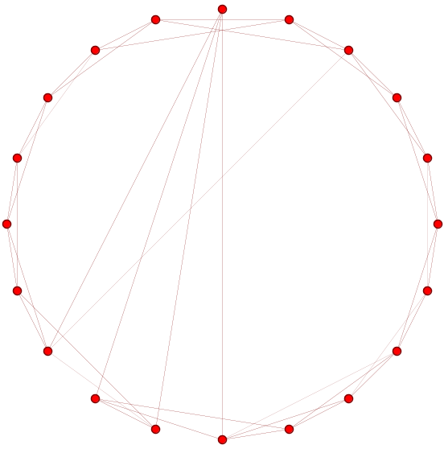
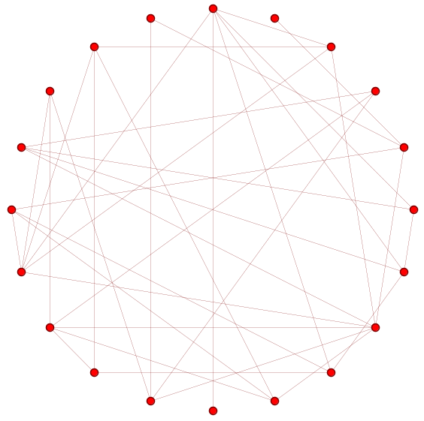
What Is a Small World Network Structure?
Watts & Strogatz 1998
Lattice
Small World
Random
High Local Efficiency
Low Local Efficiency
Low Global Efficiency
High Global Efficiency

Slide 19
An Implicit Theory of Contractual Variation Different network structures may necessitate different contractual responses

Slide 20
Evidence from Biotechnology One of my projects explores the braiding and network governance theses in the context of biotechnology innovation, because detailed data on the collaboration network is publicly available

Slide 21
Biotechnology Is Not a Small World
20 years of contract data reveals a highly diverse and dynamic collaboration network, and little evidence of a small world
Network of alliance relationships in SIC 2834
Vertices = 8,515
Edges = 33,279
Clustering Coeff = 0.149
Assortativity = -0.182

Slide 22
When Are These Committees Used?
A governance committee has decision authority, has equal numbers of representatives, and operates by a unanimity rule
Source: Jennejohn 2016

Slide 23
Results of Logistic Regression Analysis of Main Effects of Prior Deals and Network Centrality on Formal Contracting
Select Results

Slide 24
A New View of Networks In the biotechnology network, formal contracts are designed to respond to network-based risks—i.e., the network is a source of exchange hazards (such as spillover risk), not necessarily a response to them

Slide 25
Take-Aways
There is an important role for public institutions to play in a very complicated new form of economic organization
Understanding collaborative contracting requires acknowledging that there are more exchange hazards than hold-up
Governance choices are contingent upon complex combinations of exchange hazards
Industry-by-industry approach is a good way to reduce conceptual complexity, but industries are not static
Path dependency matters but it does not dominate

