Slide 1
UACMD
FEB 2025
Agricultural finance: Unlocking potential with crop receipts
Kyrylo Mukhomedzyanov
Project Lead

Slide 2
Agriculture finance gap is a global challenge
The global agricultural financing gap is estimated at $200B annually
35%
of the world’s food is produced by smallholder farmers…
…yet
millions
remain financially excluded – lacking access to pre-harvest financing due to weak collateral and systemic market failures
Source: FAO
2
Notes:
Sources: https://www.fao.org/family-farming/detail/en/c/1398060/
https://www.agritecture.com/blog/agri-financing-crowdfunding-defi-bridging-funding-gap#:~:text=According%20to%20the%20Food%20and,to%20meet%20rising%20food%20demands.

Slide 3
Transforming future crop into immediate financing
Crop receipt
Brings farmers and creditors together
by using future crops as collateral
is a document of title that establishes the debtor’s unconditional obligation, secured by a right in commodities, to deliver agricultural products or to make payment under agreed terms
Facilitates pre-harvest financing,
allowing access to inputs like seeds, fertilizers, and equipment
Formalizes agricultural credit,
making financing more predictable and enforceable

Slide 4
Types of crop receipts
Commodity crop receipt
to deliver a fixed quantity of single crop.
It is possible to specify the formula for conversion of the crop’s quantity depending on its quality.
Financial crop receipt
to pay the amount of money that can be determined by the formula which is:
fixing the value on the date of issuance
linking to any variables (i.e. price, currency rate) to calculate the value in future

Slide 5
Crop receipts: Unlocking key financial opportunities for farmers​
Secure inputs:​
Crop protection, fuel, fertilizers, ​ and seeds through trade credit​
Access new markets:​
Expand the structure of production ​ and enter new markets​
Access finance:​
Unlock bank loans for working capital ​and capital expenditures​
Guarantee sales:​
Ensure prepayment & reduce commercial risks for producers​

Slide 6
Brazil’s success: Crop receipts driving billions in financing
Brazil had limited agriculture growth due to a lack of finance
1994
Introduction of crop receipts
Established CPRs, allowing farmers to secure financing with future crops while giving lenders a reliable repayment instrument
2001
New forms of crop receipts
Introduced CPR-F, enabling cash-settled transactions, attracting financial institutions, and broadening refinancing options
2004-2009
First securitization issued
Created CRA, a securitization vehicle for CPRs, unlocking domestic & international investment via capital markets
2020
Modernization and digitalization
Enabled electronic issuance, endorsement, and registration, streamlining pledging, financing, and trading
Today
Market growth & innovation
Widespread digitalization, mandatory registration, and fintech expansion have fueled rapid growth in CPR financing, trading, and securitization
Commercial credit growth replacing state subsidies
Market uptake leading to $3B in mobilized capital annually
Over $10B in active issuance in 2019
Total financing reaches $17B annually
Total financing reaches $31B in 2022

Slide 7
Crop receipts in Ukraine: Key milestones
2015
2022-2023
Feb 2024
IFC launched flagship Ukrainian project to secure financing for farmers who lack collateral
Adaptation to wartime realities, supporting the government, creditors, and farmers in renewing financing on crop receipts
The Law on Agrarian Notes adopted
Dec 2024
Finalization of regulations and digital infrastructure development
2015-2020
2021
Today
Achieved over
USD 1 billion
in financing
IFC launched UACMD Project to modernize and pilot securitization of crop receipts
Building market capacity and raising public awareness

Slide 8
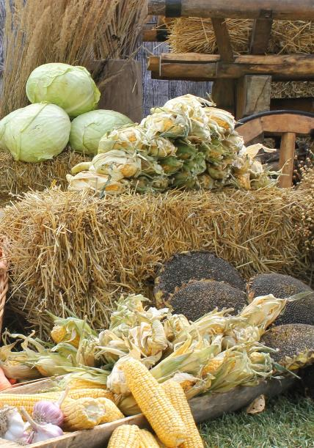
Ukraine’s success: From zero to hero
As of February 1, 2025
$2.2B
10,401
2,500+
47
total value under crop receipts
crop receipts issued
farmers reached
crops pledged

Slide 9
Building a playbook for global crop receipts success
Technical assistance
Pilot importance
Training necessity
Innovative business models
Ukraine’s lessons
01
02
03
04
Role of court practice
Opposition risk
Cross-border aspect
Securitization
Digitalization
05
06
07
08
09

Slide 10
On track to global replication: We are just getting started
The UACMD Project is working to export the success of crop receipts to five new countries:
Kosovo, Pristina
Georgia, Tbilisi
Albania, Tirana
Azerbaijan, Baku
Peru, Lima

Slide 11
The legal backbone of crop receipts: A proven framework ready for implementation
Crop receipts implementation require adopting of the law which:
Introduces the definition of crop receipts
Recognizes crop receipts as "securities" for the purposes of securities legislation
Expressly allows the creation of security rights in "future crops"
Sets types of crop receipts into commodity and financial
Sets rules for registration of notices of security rights in "future crops" in specialized registries
Provides for swift out-of-court enforcement

Slide 12
GLOBAL OPPORTUNITY
Our IFC initiative is offering a scalable model ready for implementation of crop receipts worldwide, bridging the agricultural financing gap
12

Slide 13
Advancing global finance through synergies with UNCITRAL’s Model Law
Financing mobilized in agriculture
MODEL LAW
Peru
Kosovo
Georgia
Albania
Azerbaijan
Ukraine
Brazil
1994
2012
2025

Slide 14
Beyond Secured Transactions: A comprehensive legal approach for crop receipts
Law on Secured Transactions:
National Law & Regulations:
Crop receipts link to UNCITRAL:
Crop Receipts legislation must align with the Law on Secured Transactions
Adopting public Law on Crop Receipts
Harmonized with international secured transaction principles
01
Third-party effectiveness of security rights in crops must be clearly defined
Implementing regulatory frameworks
Proven model for developing legal frameworks globally
02
Transparency in enforcement mechanisms for secured creditors is crucial
Developing a Centralized Register
Scalable solution for diverse agricultural market
03

Slide 15
Q&A SESSION
FEB 2025
Let’s shape the future of agri-finance together
Kyrylo Mukhomedzyanov
Project lead
38097 84 11 373
KMukhomedzyanov@ifc.org

