Slide 1
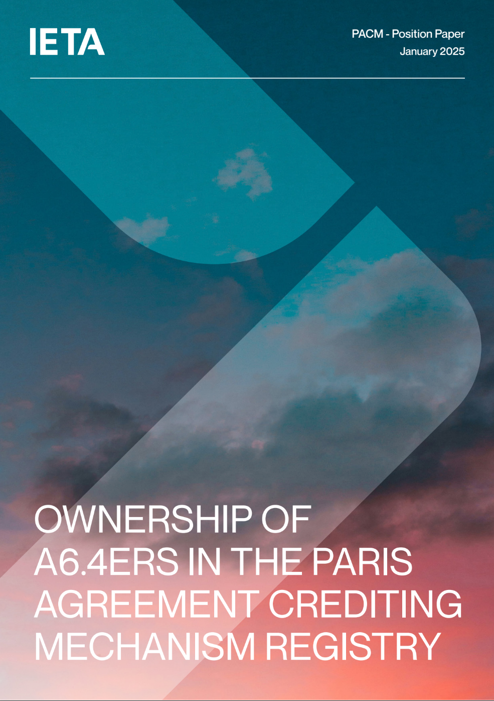
OWNERSHIP OF A6.4ERs IN THE PACM REGISTRY
The first units under the Paris Agreement Crediting Mechanism are expected to be issued in 2025 and work is underway to establish a registry.
Currently, the CMA “has not provided guidance on the recognition of ownership with regards to units held in the mechanism registry, nor how the registry may or may not recognize ownership, and/or financial security interests.”

Slide 2
OWNERSHIP OF A6.4ERS HELD IN PACM REGISTRY
Key Issue – Two Options
ONE- Frame users’ rights with regard to control, with no acknowledgement of ownership
TWO - Confirm ownership: obtain proof of ownership documentation, transfer in Registry constitutes a transfer of ownership; disputes relating to ownership of units shall be left to either private dispute resolution if between account holders and/or third parties
IETA View – OPTION 2
Enables core market activities necessary for finance to flow, including the transparent and consistent transfer of ownership
Facilitates the scaling of finance by enabling security arrangements in and around Registry accounts; and
Facilitates development stable market infrastructure

Slide 3
OWNERSHIP OF A6.4ERs IN THE PACM REGISTRY
Markets operate through the transfer by way of sale and/or security of ownership
Carbon markets - settlement of sale and purchase transactions by transfer of credits between accounts
Recognition of ownership provides some certainty on perfection of transfer of ownership
Particularly important in instances where ownership itself may be under dispute e.g. contractual claims or insolvency
And critical where using credits as security to raise finance
Account A
Account B
Account B (seller) instructs Registry Operator to transfer credits to Account C (buyer)
Registry
Account C
Account D

Slide 4
OWNERSHIP OF A6.4ERs IN THE PACM REGISTRY
Registry Account B
Markets operate through the transfer by way of sale and/or security of ownership
And critical where using credits as security to raise finance
Security Agreement between investor and borrower
Enforcement through Registry operator
Registry
Registry Account C
2. Investor takes security over credits in account
$$ from Investor to Party C Project Proponent
3. Registry operator recognises security and acts on Secured Party instruction
Investor

Slide 5
DEVELOPMENT OF CUSTODIAL ARRANGEMENTS
Transactions between parties with accounts at different custodian Banks aggregated between Custodian Banks and settled by book entry transfer at the Registry, reducing traffic at the Registry
Facilitates entry into market of Regulated Financial Undertakings (RFU) that may provide sub-custodial accounts
Aids liquidity – potential to have multiple types Carbon Credit accounts with same RFU
Provides a layer of market oversight as such entities are already regulated and must perform stringent on boarding procedures and monitor activity
Enables secured financing structures
- administered by the RFU
provide transparent ratings for structured financing
Sub- account
Sub- account
Sub- account
Transactions between parties with account at same custodian Bank settled by book entry transfer by the Custodian Bank, balance at Registry does not change.
Custodian Bank Account
Sub- account
Account B
Sub- account
Custodian Bank Account
Registry
Account C
Sub- account
Custodian holds ownership for and on behalf of sub account holders

Slide 6
BALANCE BETWEEN TRANSPARENCY AND CONFIDENTIALITY
Transparency
Transparency enables informed decisions, fosters fair competition, and reduces risk of fraud and manipulation
Valuable and possibly essential, for aggregated and anonymized market and project data to be transparent, in addition to data on what units have been retired and for what purpose
Confidentiality
Commercially sensitive information is critical in maintaining trust, efficiency, and fairness in markets
Disclosure of proprietary or sensitive business data could harm a party’s competitive position or violate contractual or legal obligations, including specific account holdings and commercial terms of transactions including pricing and volumes
Lack of confidentiality would be an obstacle to development of a market mechanism

