Slide 1
Rights to Payment in Supply Chain Finance
Dr. Marek Dubovec
International Law Institute and
James E. Rogers College of Law, University of Arizona

Slide 2
Rights to Payment under the UNCITRAL Model Law on Secured Transactions (MLST)
Defined and specific rules
Receivables
Money
Bank accounts
Non-intermediated securities
Expressly excluded
Independent undertakings
Intermediated securities
Negotiable instruments
Payment rights arising from financial contracts

Slide 3
Payment Rights Beyond MLST
UNCITRAL Model Law on Electronic Transferable Records (MLETR) enables
Electronic negotiable instruments
UNIDROIT Principles on Digital Assets and Private Law (DAPL) enables
Linked digital assets, such as digital invoices
Digital assets, such as cryptocurrencies
Central Bank Digital Currencies
ICC Uniform Rules for Digital Trade Transactions (URDTT) enables
Payment obligation
FSP payment undertaking

Slide 4
Domestic Approaches
Electronically recorded monetary claims (2006 Japanese law)
Negotiable electronic invoices (2010 Peruvian law)
Controllable accounts (2022 U.S. law)

Slide 5
How to Design a Secured Transactions Framework for Supply Chain Products?

Slide 6
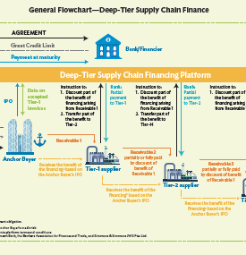
Deep-tier Supply Chain Financing
Payment obligation of the anchor buyer
evidenced in:
1. receivable (Model Law on Factoring)
2. electronic transferable record (MLETR)
3. digital token (DAPL)

Slide 7
Considerations for Future Work
Lack of coverage?
Lack of asset-specific rules, including on conflict of laws?
What guidance might be valuable for States?
How to create a coherent legal framework?
How to enable specific supply chain products?
Desirability to introduce changes affecting the MLST implementation?

